Slide 1
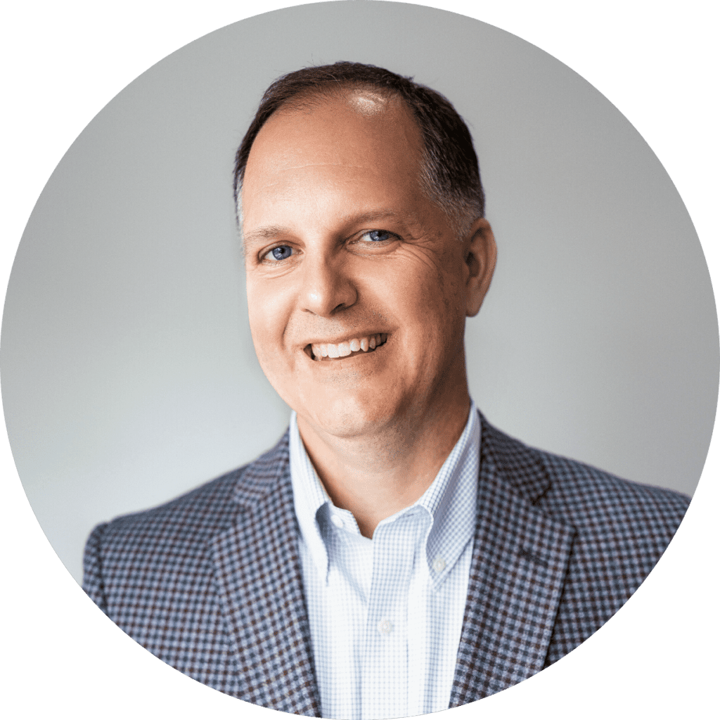
Cybersecurity Overview
Here with you Today: Mike Polce
Founder & Chief Executive Officer
Rick Pollard
Vice President for Strategy & Business Development

Slide 2
About Us
25+ Years Providing IT & Cybersecurity Services
Headquartered in the Griffiss Technology Park with offices in Syracuse.
Dedicated Cyber Practice (CISM/CISSP)
24 x 7 x 365 Operation – Ready to Respond
Compliance Expertise in NIST, CMMC, and others
Large Public Sector Presence
SOC 2 Type II Compliant
2024
M.A. POLCE

Slide 3
Verizon Security Report
2025

Slide 4
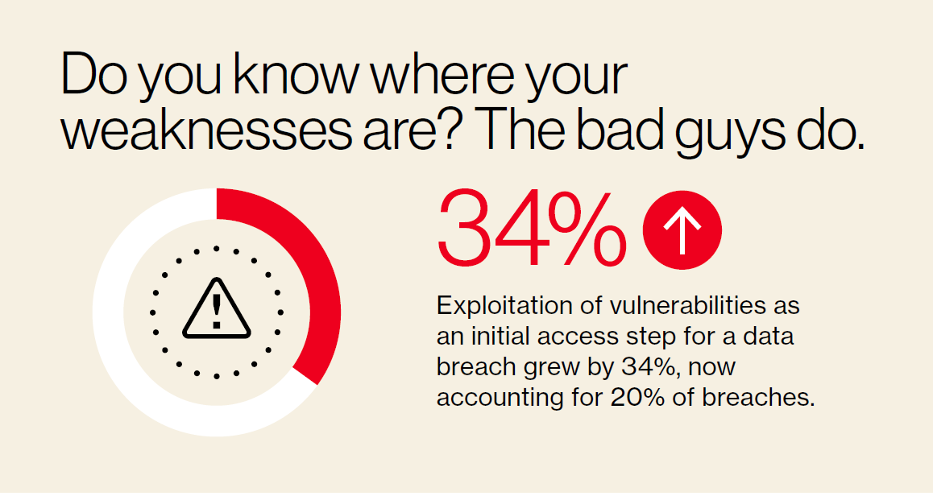
2024
M.A. POLCE

Slide 5
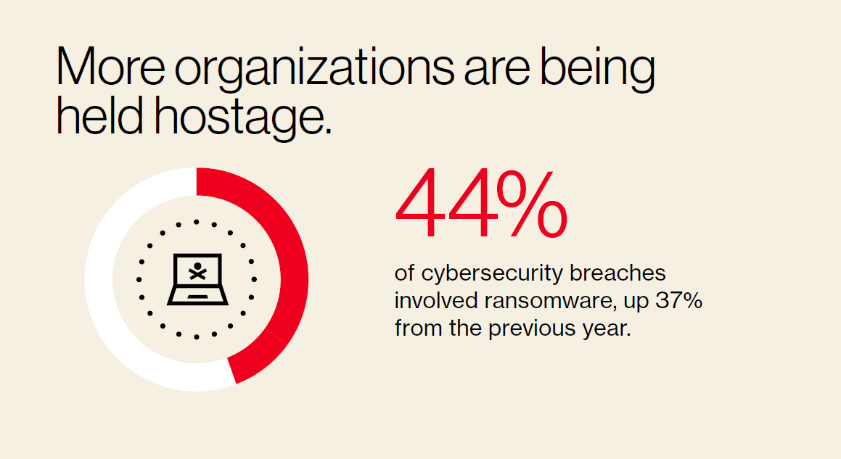
2024
M.A. POLCE

Slide 6
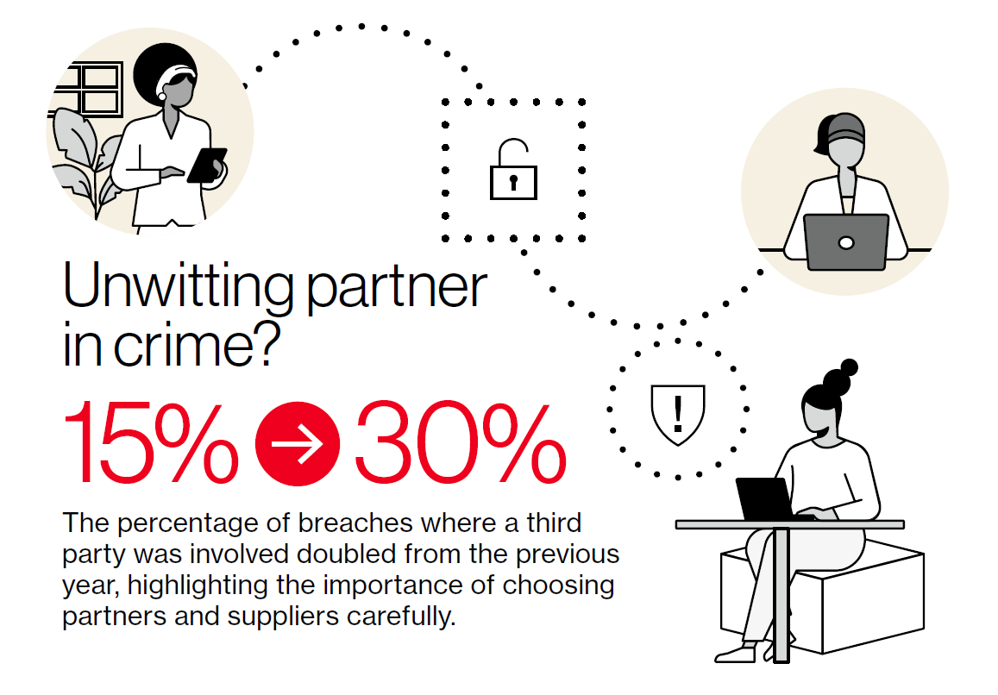
2024
M.A. POLCE

Slide 7
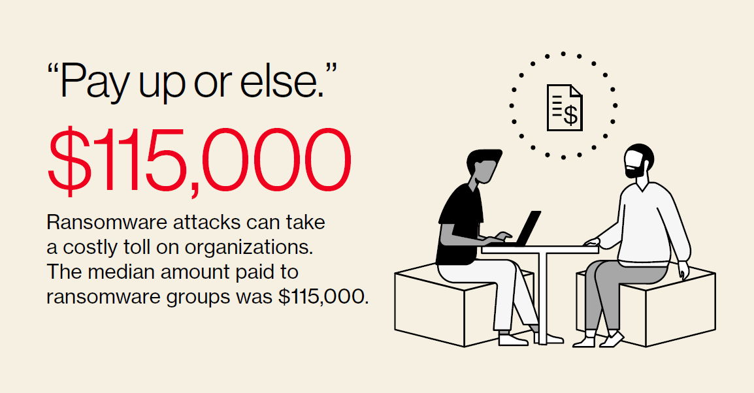
2024
M.A. POLCE

Slide 8
2024
M.A. POLCE

Slide 9
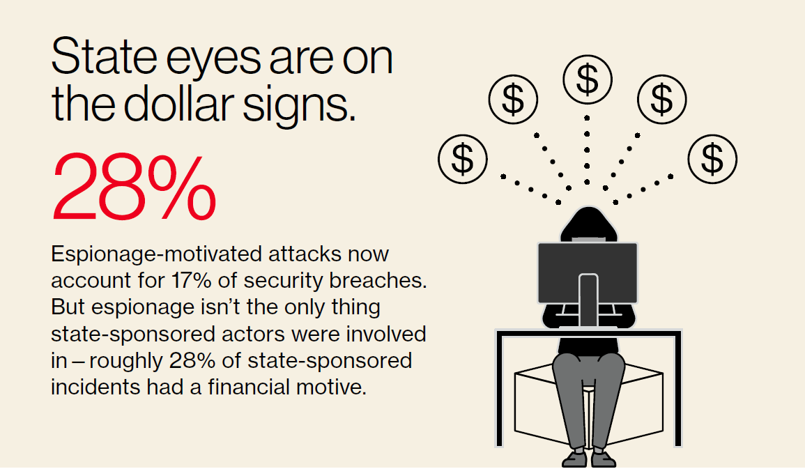
2024
M.A. POLCE

Slide 10
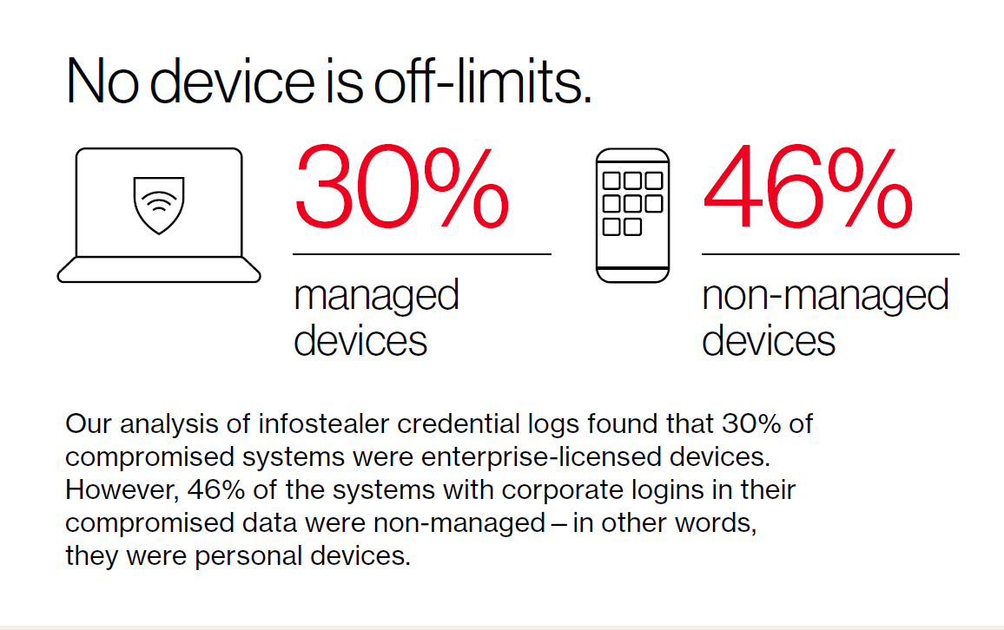
2024
M.A. POLCE

Slide 11
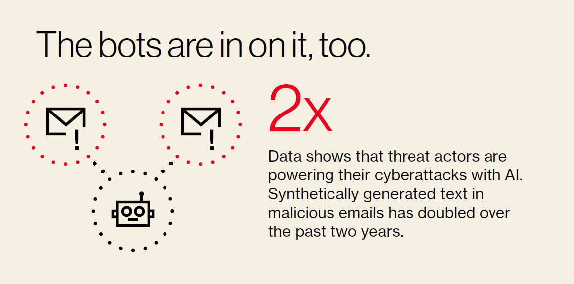
2024
M.A. POLCE

Slide 12
Types of Attacks
Ransomware
Stolen Credentials
Exploiting Vulnerabilities
Phishing
44%
32%
18%
14%

Slide 13
Case Study:
Direct Deposit Scam
Spoofed email to payroll clerk
Changing direct deposit via pdf form
No verification process in place

Slide 14
Case Study:
Internal Auditors; Information Grab
Spoofed email to administrative assistant
Spoofed website mimicking internal auditors website
Request to upload sensitive financial information
No verification process in place

Slide 15
Case Study:
Timeline of a Ransomware Attack
11:08 AM
11:08 AM
11:10 AM
11:16 AM
SOC alerts on the addition of an admin account via remote executions.​
SOC analyst begins triaging the event.​
SOC analyst escalates the event to a senior analyst.​
SOC senior analyst begins the investigation.​
Threat isolated in 11 minutes;
customer operations fully restored within 2 hours
11:19 AM
11:23 AM
SOC senior analyst eliminates the threat by isolating domain controllers.​
POC is contacted with details of the incident and recommendations for the next steps.

Slide 16
Implications of Ransomware
Operational Downtime
Risk of Sensitive Data Leak & Extortion
Damage to Reputation & Trust
MONEY! Ransome Payouts, Insurance Hikes, Recovery Efforts, Lawsuits
Loss of Insurance
Increased Likelihood of Future Ransomware
Business Continuity Problems

Slide 17
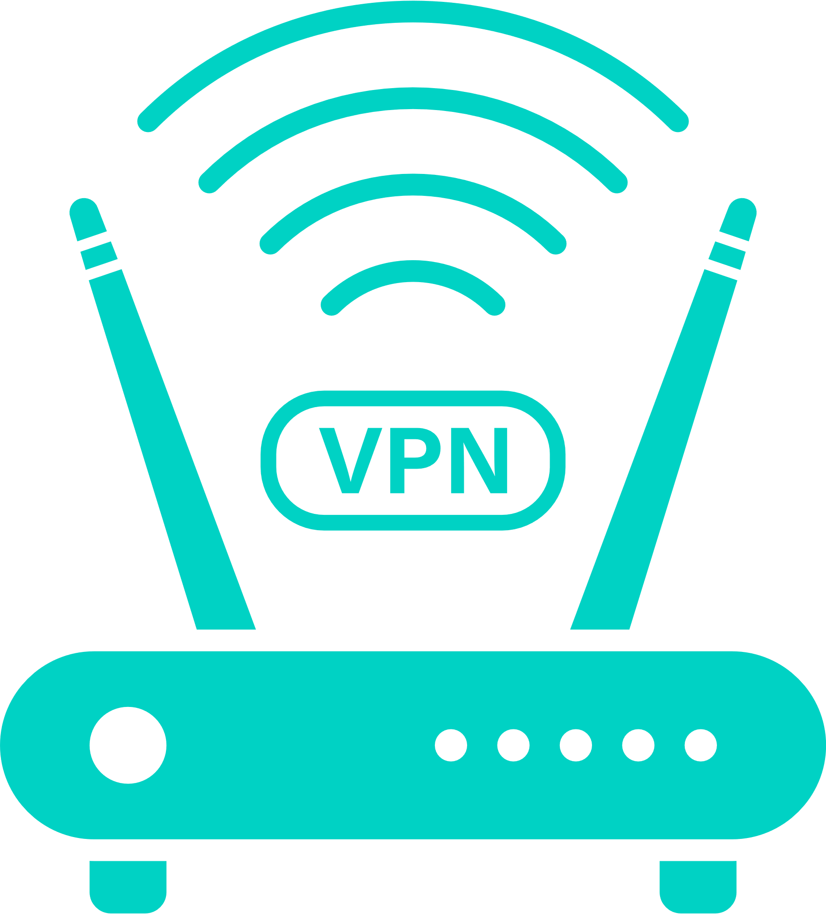
Cybersecurity
Checklist
24x7 Managed Detection & Response
Secure Remote Access
Security Awareness Training
Backup & Data Recovery
Multifactor Authentication
Email Security
Vulnerability Testing & Patching
Gov. Risk & Compliance

Slide 18
Compliance & Oversight

Slide 19
What is Governance, Risk, & Compliance (GRC)?
Governance The practice of creating and implementing security policies, procedures, and internal systems focused on protecting the organization.
Risk An evaluation of an organization’s potential for being attacked or compromised.
Compliance Adherence to an established framework of standards such as NIST, HIPAA, CMMC, or a set of guidelines such as the NYS Shield Act or the FTC Safeguards.

Slide 20
The Cyber Risk Landscape
PHAs are increasingly targeted by ransomware and phishing attacks.
They manage sensitive resident data: PII, income, housing records.
A breach or downtime can harm operations and vulnerable populations.
Cyber incidents are a matter of 'when', not 'if'.

Slide 21
Top Challenges for PHAs
Outdated systems and legacy infrastructure.
Limited budgets and small IT/security teams.
Heavy reliance on third-party vendors and cloud tools.
Need to comply with multiple regulations (HUD, state, local).

Slide 22
Key Leadership Priorities
Treat cybersecurity as a strategic priority at the board level.
Ensure appropriate funding for modern, secure IT systems.
Support development of incident response and risk policies.
Ask key questions: Are we protected? Are we prepared to respond?

Slide 23
Practical Steps to Strengthen Cyber Resilience
Implement Multi-Factor Authentication (MFA).
Train staff to detect phishing and report incidents.
Establish and test an incident response plan.
Evaluate and manage third-party vendor risks

Slide 24
Final Message for Leadership
Cybersecurity is not just IT—it’s a core part of public service delivery.
Leadership sets the tone for a secure and resilient culture.
Protecting systems protects resident safety and agency stability.
Be proactive, ask the right questions, and invest in resilience.

Slide 25
Choosing a Partner

Slide 26
Core Service Areas
Managed IT
Full assistance with the daily management of your IT deployment.
Cybersecurity
Foundational security to comprehensive cyber protection.
Professional Services
IT project planning, procurement, implementation, and on-going support.

Slide 27
Managed IT
Comprehensive IT Management
Support and management of your core network​ infrastructure, systems, and workstations including patch management, data backup, 24×7 monitoring and alerting, help desk, a suite of security components, and more.​
Technology Services
Backup & Data Recovery Services
Cybersecurity Services
Microsoft 365 (M365) Services

Slide 28
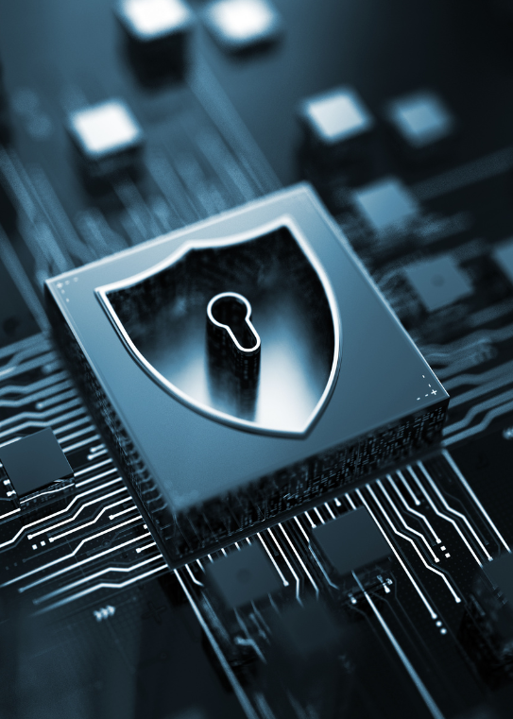
Managed Detection & Response (MDR)
Cybersecurity Services
Have security analysts watch your network around-the-clock, ready to respond 24x7x365 to stop advanced attacks in their tracks.
Governance, Risk, & Compliance (GRC)
Continuously assess and strengthen your security posture and drive toward compliance with a detailed security roadmap.
Managed Cyber+ (MC+)
Engage in a highly supportive security ecosystem with a tailored program guided by a certified security professional.
Additional Services
Email Security
Multi-Factor Authentication
DNS Security
Security & Risk Assessments
Vulnerability Scanning
Security Awareness Training
Penetration Testing
Incident Response & Readiness
Tech Hours
Endpoint Detection & Response
vCISO Hours
Policy & Plan Development

Slide 29
Professional Services
Hardware & Software Purchasing
Eliminate challenges with IT procurement, systems integration, legacy designs, and IT specialization.
Project
Management
Infrastructure
Upgrades
Contract
Access
Network, Compute, & Storage Services
Access a team that maintains certifications across several disciplines and offers a complete range of products from leading manufacturers
Networking &
Wireless
Storage &
Virtualization
Voice Systems
(VoIP)

Slide 30
Our Difference
Responsive
Experienced
Security First
People

Slide 31
CYBERSECURITY | MANAGED IT | COMPLIANCE
Security at the Core of Everything.
CONTACT: rpollard@mapolce.com | mapolce.com | 315.440.2291

